Slide 1


Slide 2







Slide 3



int dataValue;
dataValue = 100;
int myInfo = 200;

Slide 4

int total;
int grade4; int 2much;

Slide 5
int sum;
int studentCount;
int bankAccountBalance;
int level2Training;

Slide 6



int myVar;
myVar = 50; System.out.println(myVar); int anotherVar = 100;
System.out.println(anotherVar); myVar = anotherVar; System.out.println(myVar);
50
100
100

Slide 7

final int maxStudents = 25;
final int someVariable;
int someOtherVariable = 100;
someVariable = someOtherVariable;

Slide 8













Slide 9









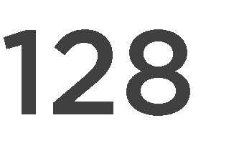
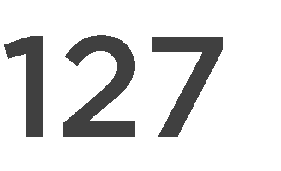


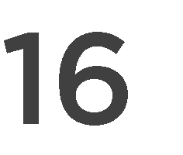

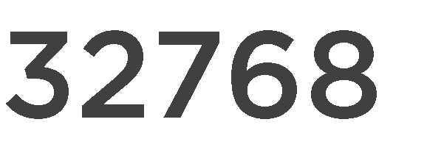
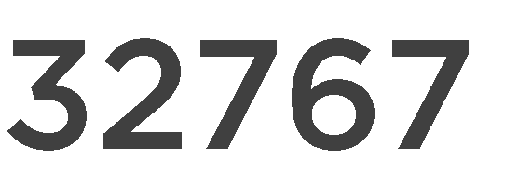

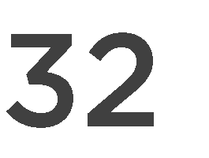

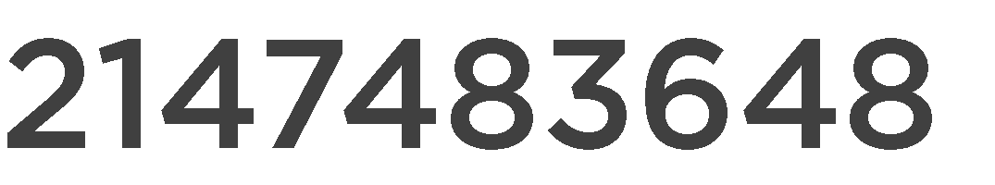
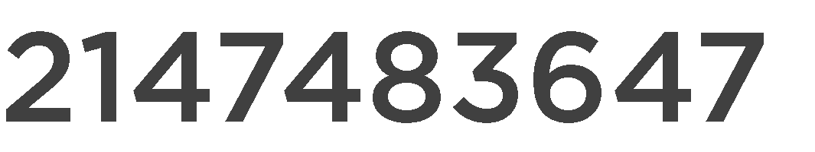

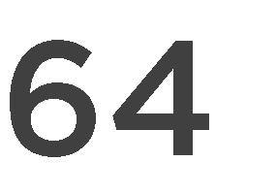

byte numberOfEnglishLetters = 26;
short feetInAMile = 5280;
int milesToSun = 92960000;
long milesInALightYear = 5879000000000L;

Slide 10





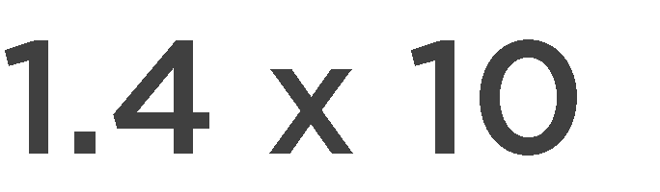
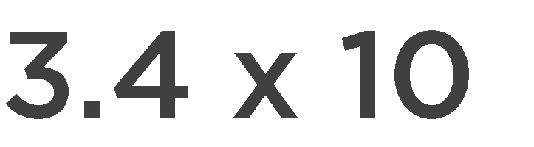


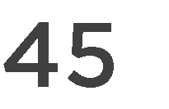


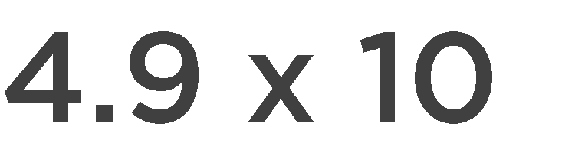



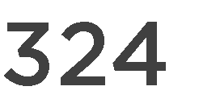

float kilometersInAMarathon = 42.195f;
float absoluteZeroInCelsius = -273.15f; double atomWidthInMeters = 0.0000000001d;

Slide 11





char regularU = 'U';
char accentedU = '\u00DA'; // Ú

Slide 12

boolean iLoveJava = true;

Slide 13
int firstValue = 100;
int otherValue = firstValue;
firstValue = 50;
otherValue = 70;
otherValue
firstValue
100
100
70
50

Slide 14














Slide 15











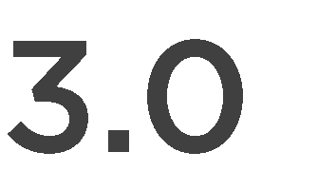
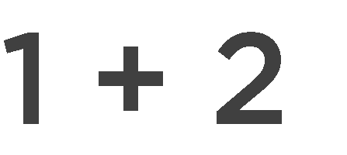
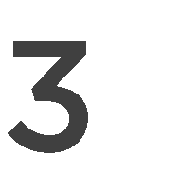


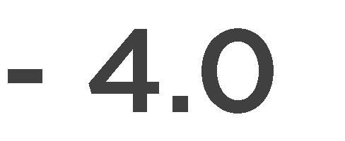



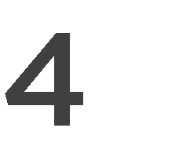



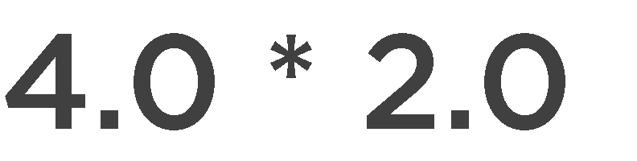
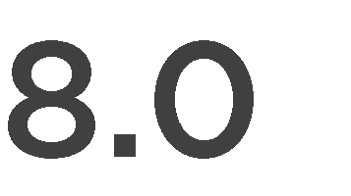
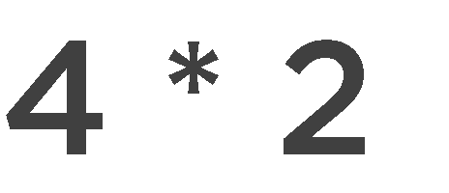



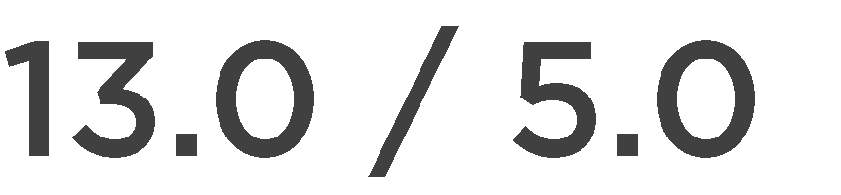
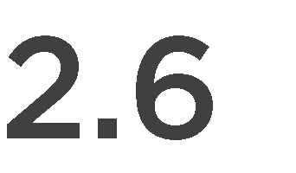
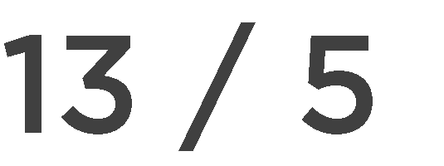



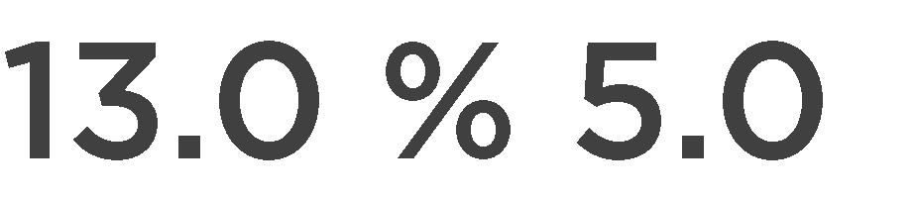
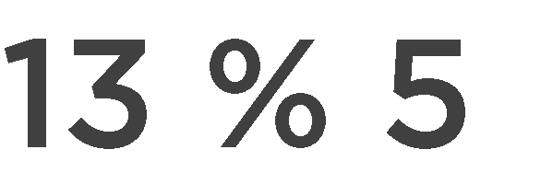

Slide 16









Slide 17

int someValue = 5;
System.out.println(++someValue); System.out.println(someValue);
6
6
int someOtherValue = 5;
System.out.println(someOtherValue++);
System.out.println(someOtherValue);
5
6

Slide 18



-
-
-

Slide 19
int myValue = 50;
myValue -= 5;
System.out.println(myValue);
45

Slide 20
int myOtherValue = 100;
50
int | val1 | = 5;
int | val2 | = 10
myOtherValue /= val1 * val2;
System.out.println(myOtherValue);
2

Slide 21

















Slide 22




( )

Slide 23

int intValueOne = 50;
long longValueOne = intValueOne;
long longValueTwo = 50;
int intValueTwo = (int) longValueTwo;
-
-

Slide 24












Slide 25








Slide 26







-
-
-
-
-
-
-

Slide 27






-
-
-
-
-
-

Slide 28



-
-
-
-

